Slide 1
SAGAR KALAUNI
2024 Analytics & Insight-Intern

Slide 2





Needed or forced
…?
How many times?
Why Unit
shut down?
Both or 1
…
Days running from?
All Unit 1 shut down dates
Coal feeder
with
status
All Unit 2
Shut down
Dates
Idea 💡

Slide 3
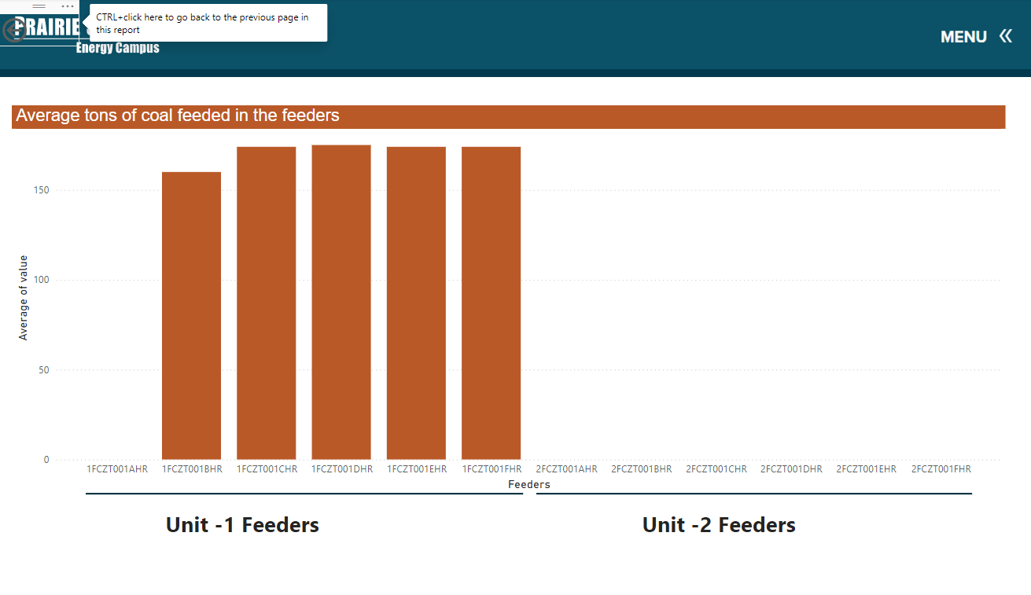
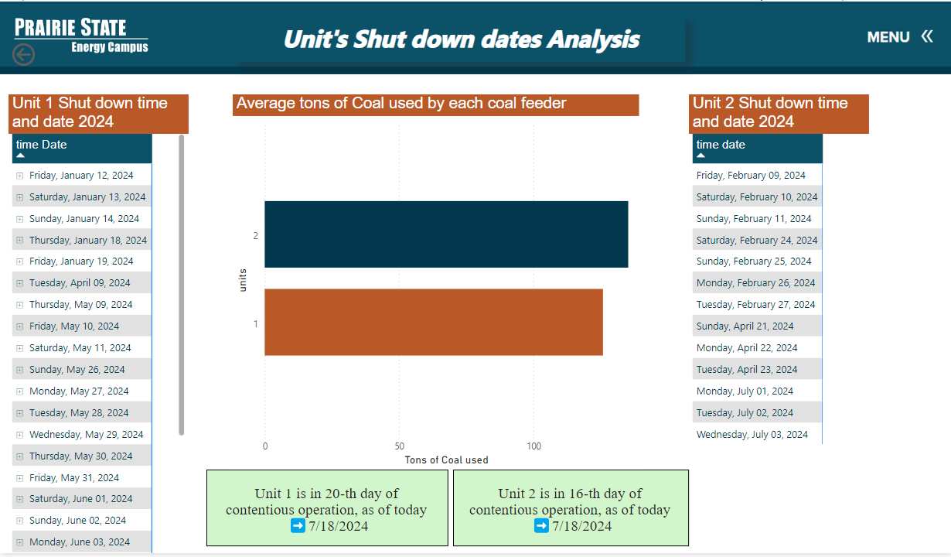
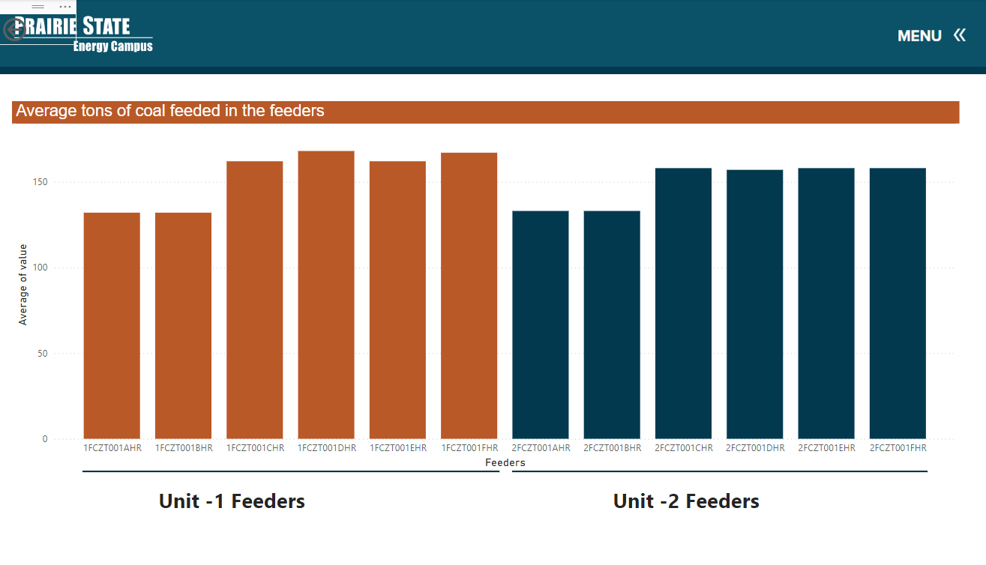
Units Shut Down dates Analysis
Goal:- To get all the dates In which Units are shutdown along with other information
Notes:
During the last week of May, Unit 1 was shut down. David gave me a tour of Unit 1, including the Boiler and gypsum walk down.

Slide 4

Special Thanks To:
Mackenzie Tabing, Josh Hagene, Jonathan Sander, Jeff Miller, Tom Foust Jr
Tyler Tiemann, Claire Beyes, Alyssa Lohmann
David Sohn, Dustin Wethen, Justin Gale
Randy Short and whole PSGC teams.

Slide 5


